Slide 1

SALES TRENDS AND CUSTOMER BEHAVIOR
Presented by: Phung Thi Minh Thuan

Slide 2
Table of contents
SALES TRENDS AND CUSTOMER BEHAVIOR
Overview
Sales Trend
Customer Behavior
Action plans

Slide 3
Overview

Slide 4
Olist is a Brazilian e-commerce platform that connects small and medium-sized businesses to customers across Brazil.
The platform operates as a marketplace, where merchants can list their products and services and customers can browse and purchase them online.
The dataset has information of 100k orders from 2016 to 2018 made at multiple marketplaces in Brazil. With multiple dimensions: from order status, price, payment and freight performance to customer location, product attributes and finally reviews written by customers
Introduction

Slide 5
Outcomes
Identify top 5 product_catergory and state has most sales
Identified peak sales periods and trends by day, week, and month.
Visualized repeat purchase behavior and retention rates over time.
Performed RFM segmentation to group customers into categories
Provide recommendations for Customer Segmentation – Personalized Marketing
Purpose
Identify top product category and state by sale
Analyze sales trends over time to identify seasonality, growth patterns, and sales fluctuations.
Uncover insights to help improve customer retention, marketing targeting, and sales strategy.
Segment customers based on purchasing habits and engagement.
Discover customer behavior

Slide 6
Sales Trend

Slide 7
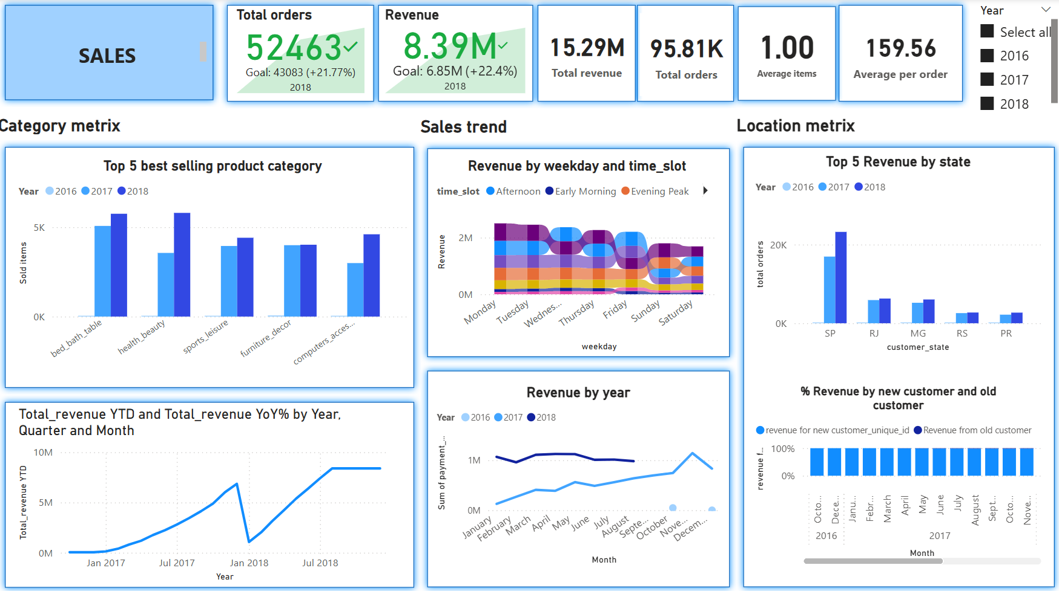

Slide 8
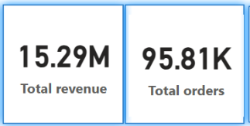
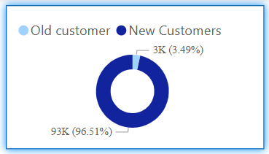
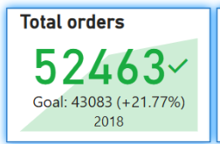
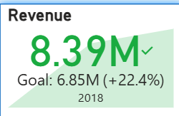
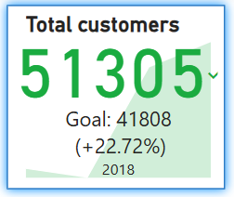
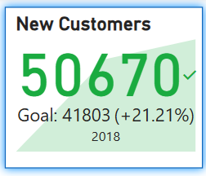

Slide 9
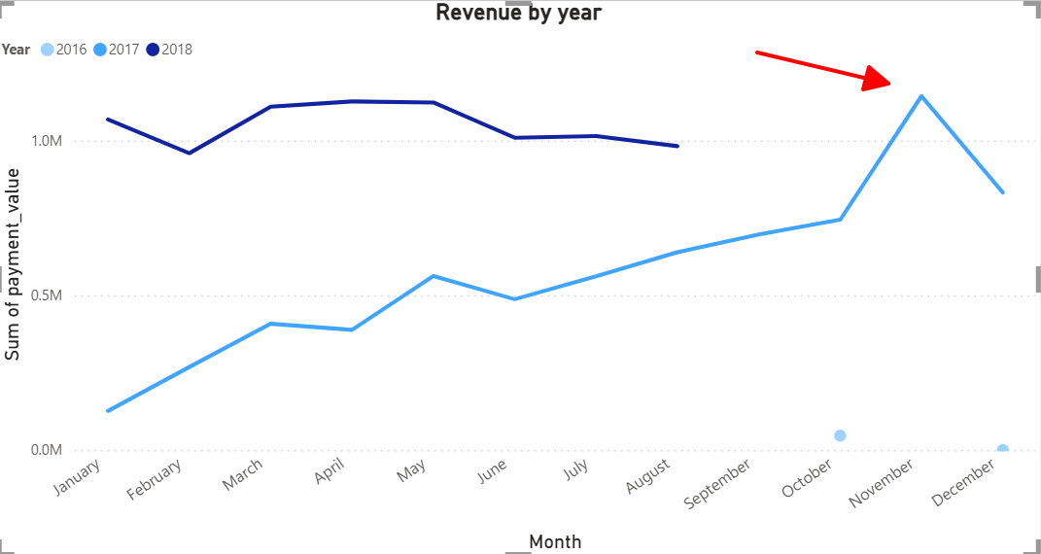
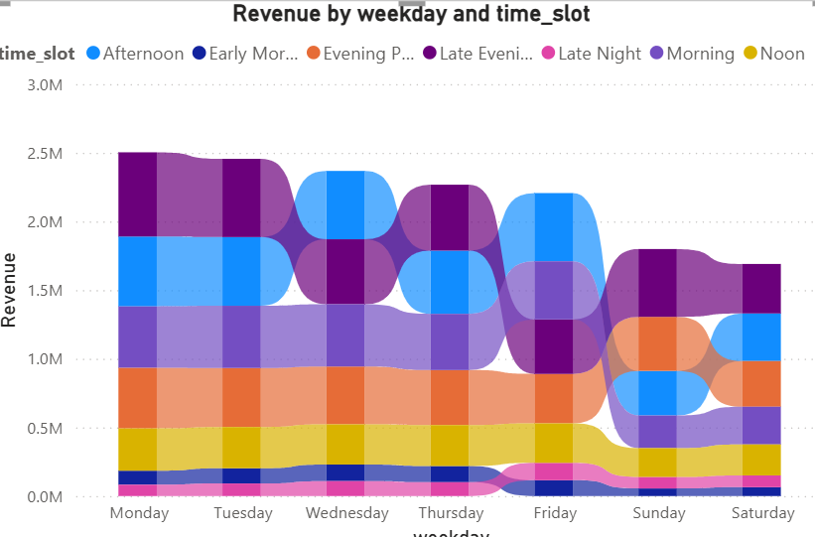
Revenue increased year over year, with a sharp surge in 2018. And peak at Nov and Dec (according 2017 data)
Highest revenue on Monday and Tuesday and on Late evening and afternoon

Slide 10
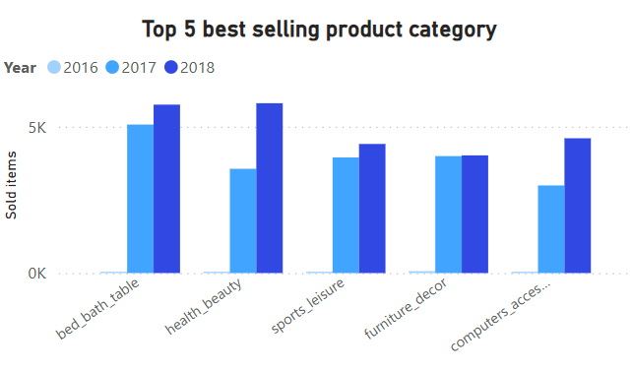
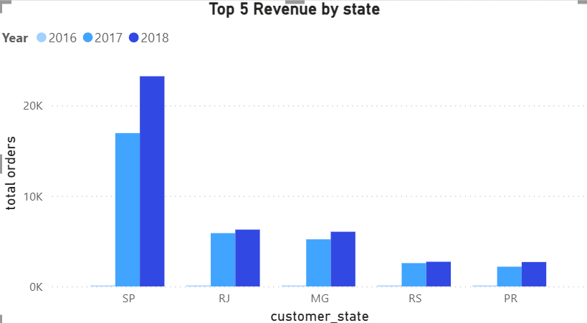
Total all products in top 5 increased items sold. Health_beauty is observed the rapid increase and become top 1 in 2018
SP account for highest solds. Only five state but account for half of total revenue

Slide 11
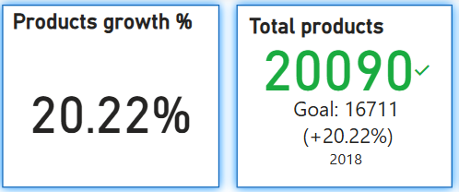
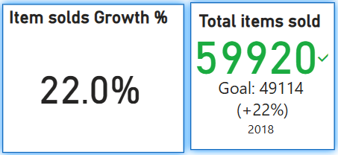
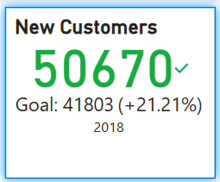
What caused the increase in sales ?
(2018 vs 2017)
🛍 Product Catalog: +20.22%, reaching 20,090 products
📦 Items Sold: ~60K (+22.45% from 49K)
👥 New Customers: +21.21%
🔥 Top Growing Categories:
Health & Beauty: +61.03% products, +62.93% demand
Bed, Bath & Table: +17.69% products
Computer Accessories: +12.44% products, +53.84% demand
(Avg Product Growth: Only +1.1%)

Slide 12
Customer Behaviors

Slide 13
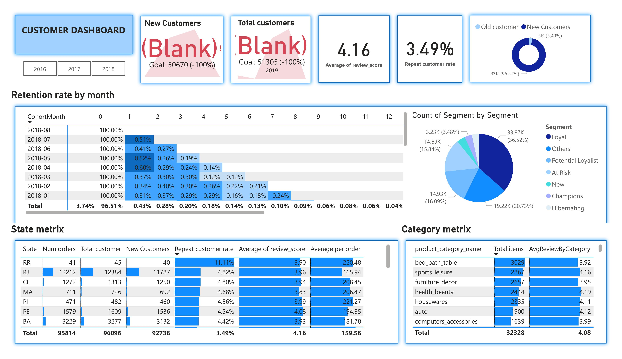

Slide 14
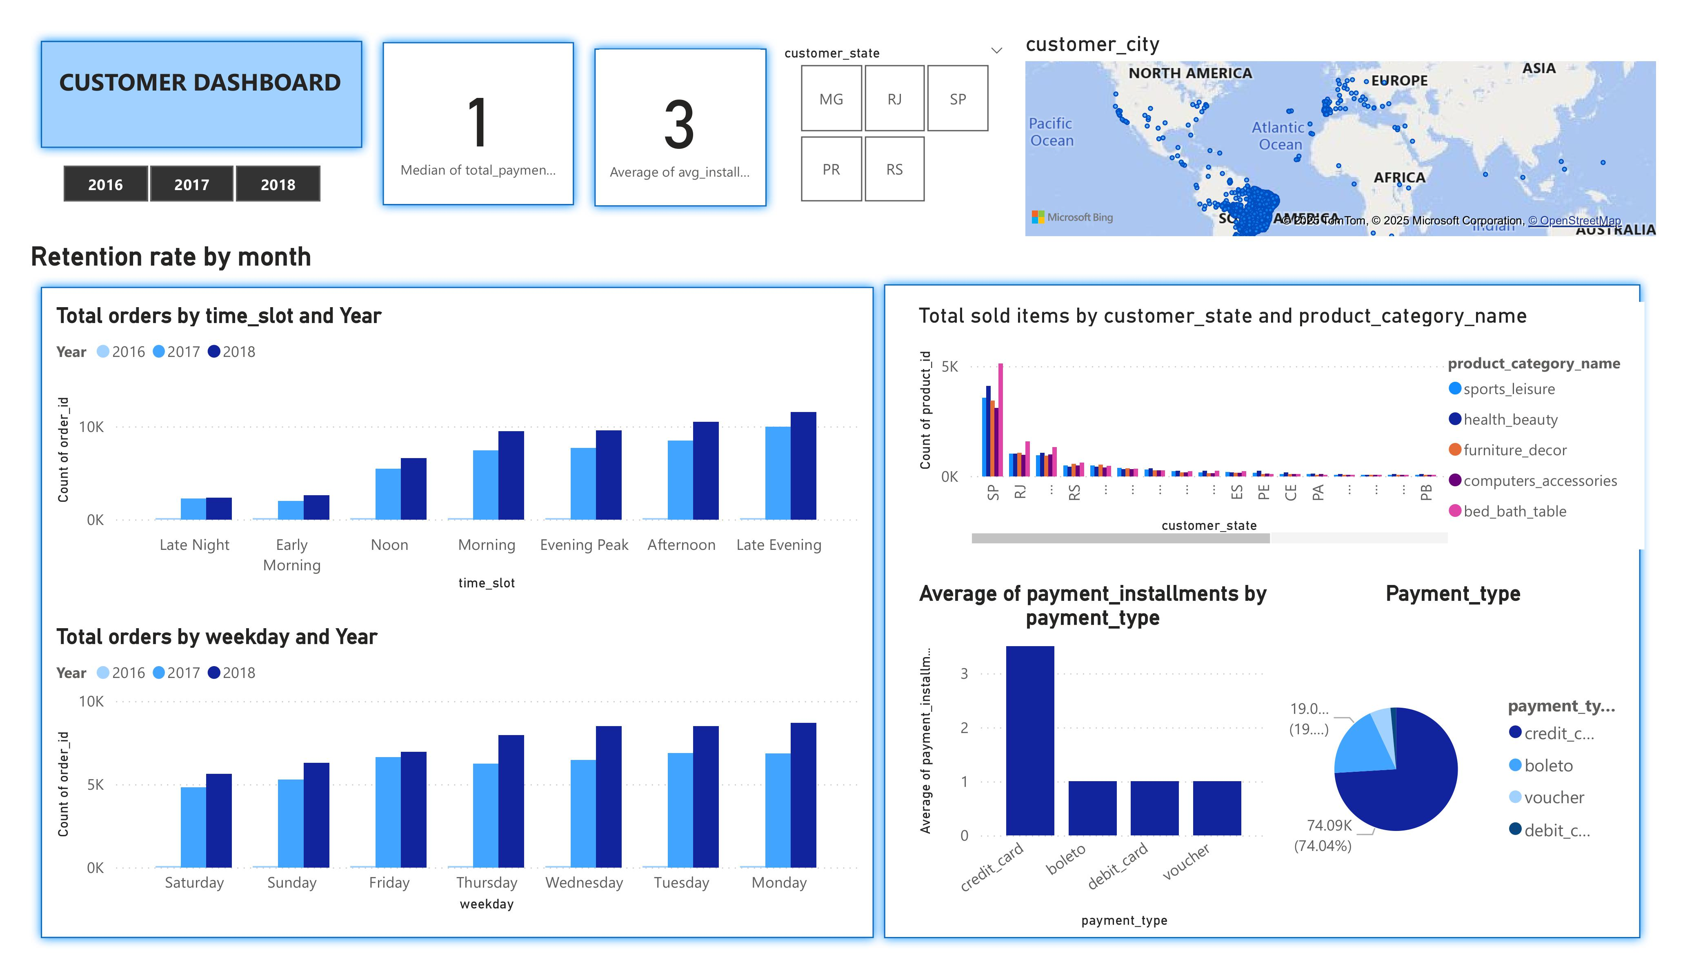

Slide 15
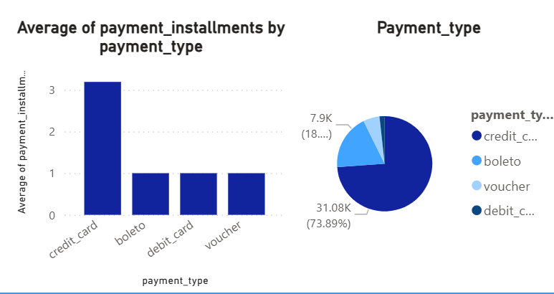
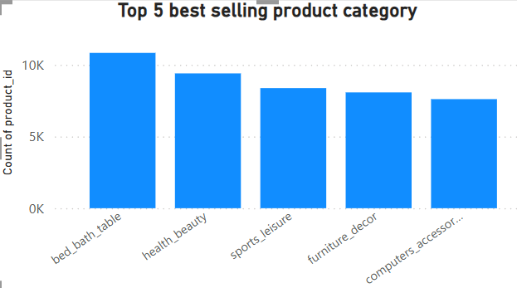
High Satisfaction: Most orders rated 5 stars, but repeat rate is low (~3.5%)
Top Locations: SP, RJ, MG, RS, PR = most buyers (low repeat); RR, RJ, CE, MA, PI = highest repeat rate & higher order value
Payment Preference: credit card is used the most
Top Product Categories: Bed_bath_table, Sport_leisure, Furniture_decor, Health_beauty, Housewares

Slide 16
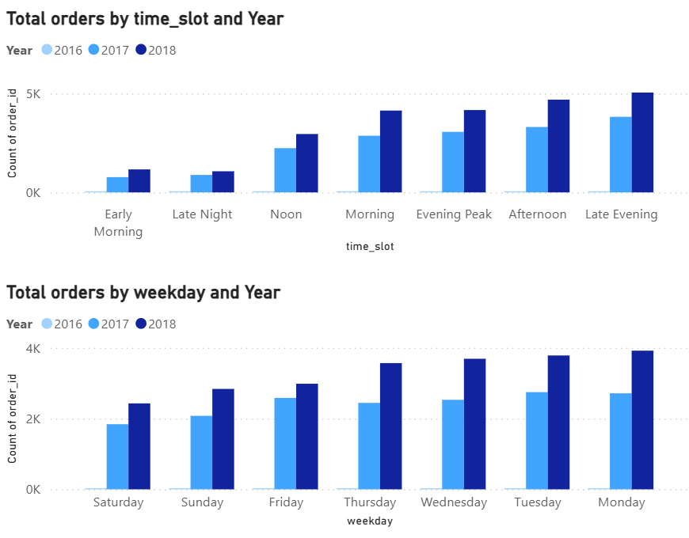
✅ Buying Behavior: Prefer to shop Mon–Tue, in late night or afternoon
✅ More Items = More Retention: Higher repeat rate with larger order sizes (Corr 0.7)
✅ Faster Delivery = Better Reviews: Delivery time affects review scores (Correlation -0.33)

Slide 17
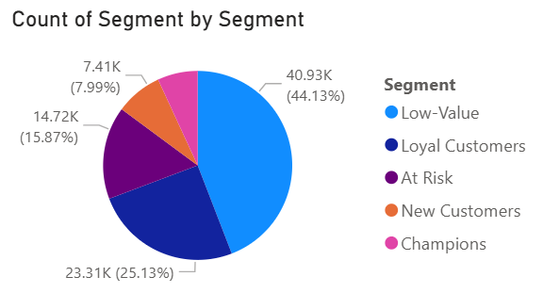
Customer Segments
Champions : These are the best customers. Customers who bought very recently (high Recency score) and spend a lot (high Monetary score)
Loyal Customers: These customers are consistent buyers and fairly recent .
New Customers: These customers just made their first or second purchase and become loyal with good engagement.
At Risk : These customers used to be active but haven’t returned lately. They need attention
Low-Value: These customers don’t contribute much currently or are inactive.

Slide 18
Actionable Plans

Slide 19
Actionable Plans
General for all segments

Slide 20
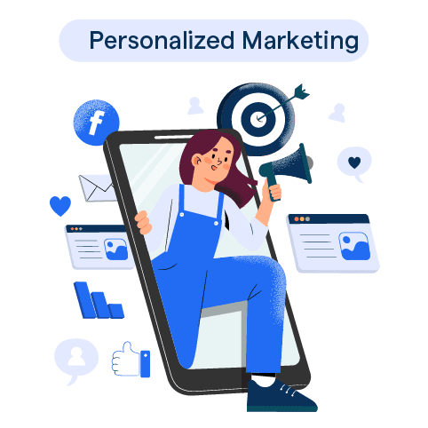
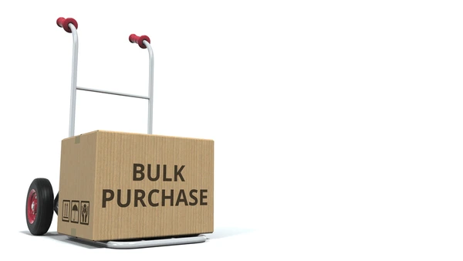

Promote Early Week: Run campaigns on Mondays & Tuesdays
Speed Up Delivery: Faster shipping boosts review scores
Personalized Marketing: Recommend top or related products and deals based on purchase history & active shopping times.
Year-End Push: Maximize sales with promotions in November & December
Encourage Bulk Orders: Cross-sell to increase items per order and retention

Slide 21
Actionable Plans
Personalize Marketing for each customer segments

Slide 22

💎 Upsell High-End: Recommend luxury or complementary products
💳 Flexible Payments: Offer extended installment options
Champion

Slide 23
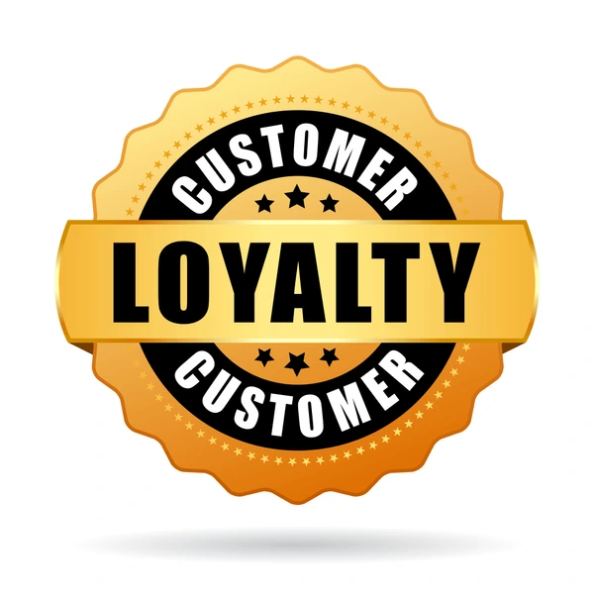
🚚 Faster Delivery: Improve satisfaction and review scores
🛍 Boost Cart Value: Use bundles or tiered discounts
Loyal Customer

Slide 24

💎 Upsell High-End: Recommend luxury or complementary products
New Customers

Slide 25

🚚 Improve Delivery: Faster, more reliable shipping to regain trust
At risk

Slide 26
Post-Purchase Care: Follow up with satisfaction surveys to increase review score
Offer Expedited shipping Options with voucher
Low Value

Slide 27

THANK YOU!

